Slide 1

Deformable Snow Simulation
Colter Snyder and Elijah Mt. Castle

Slide 2
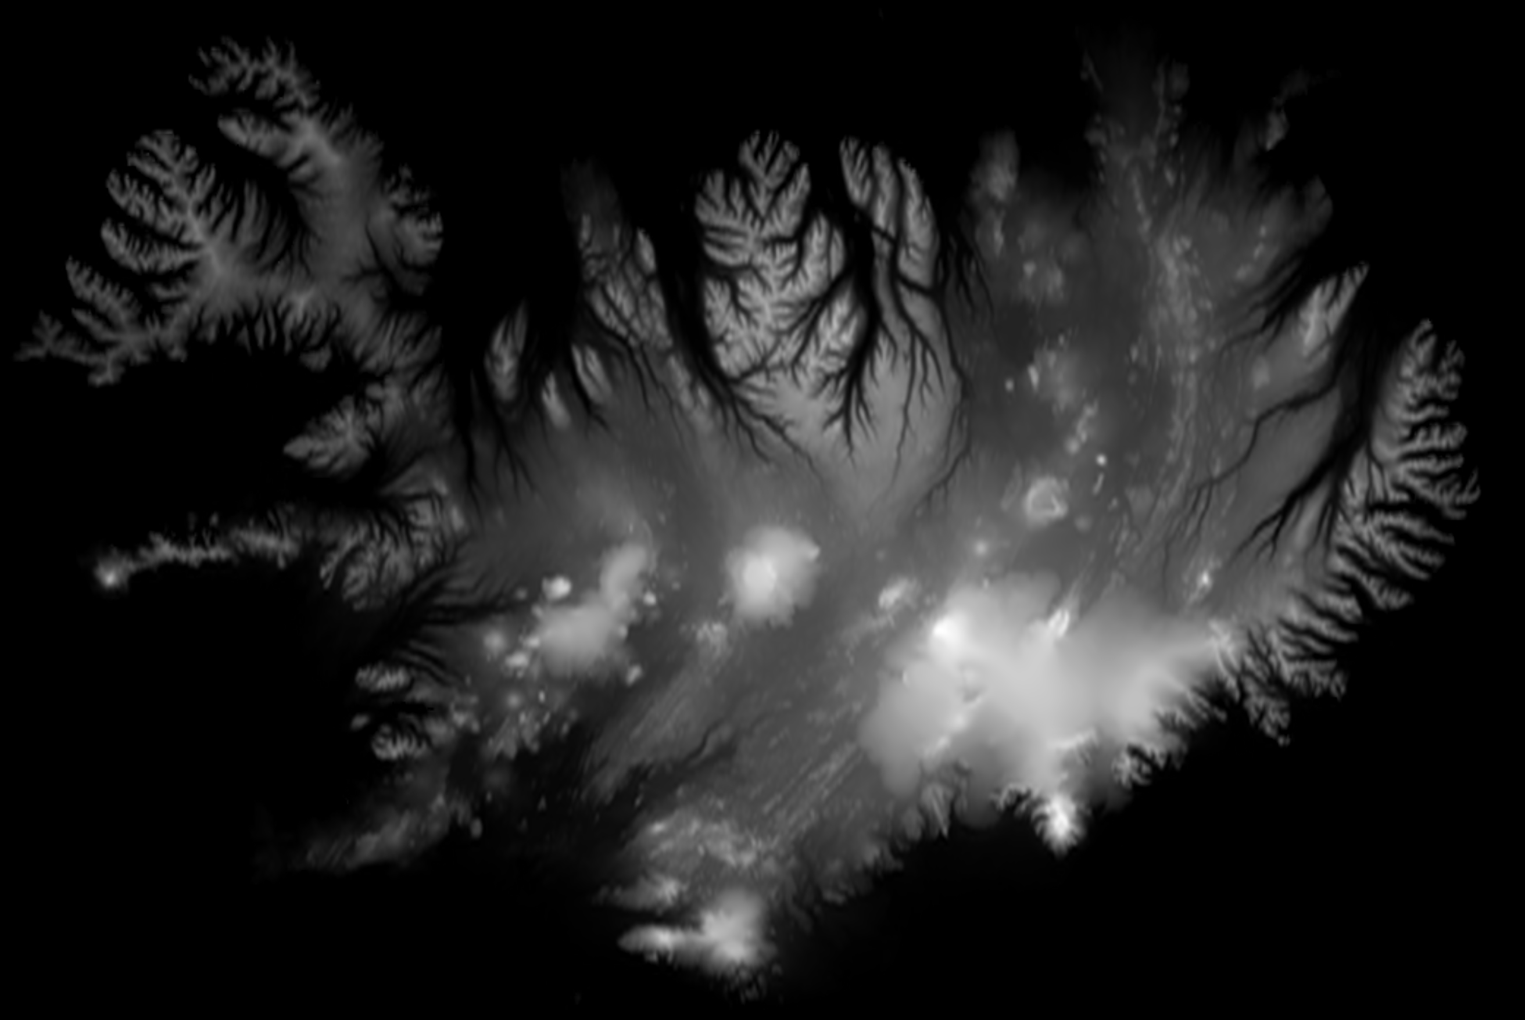
Background
We have used tessellation for generating terrain
What if we could use them for depressions in the ground?

Slide 3
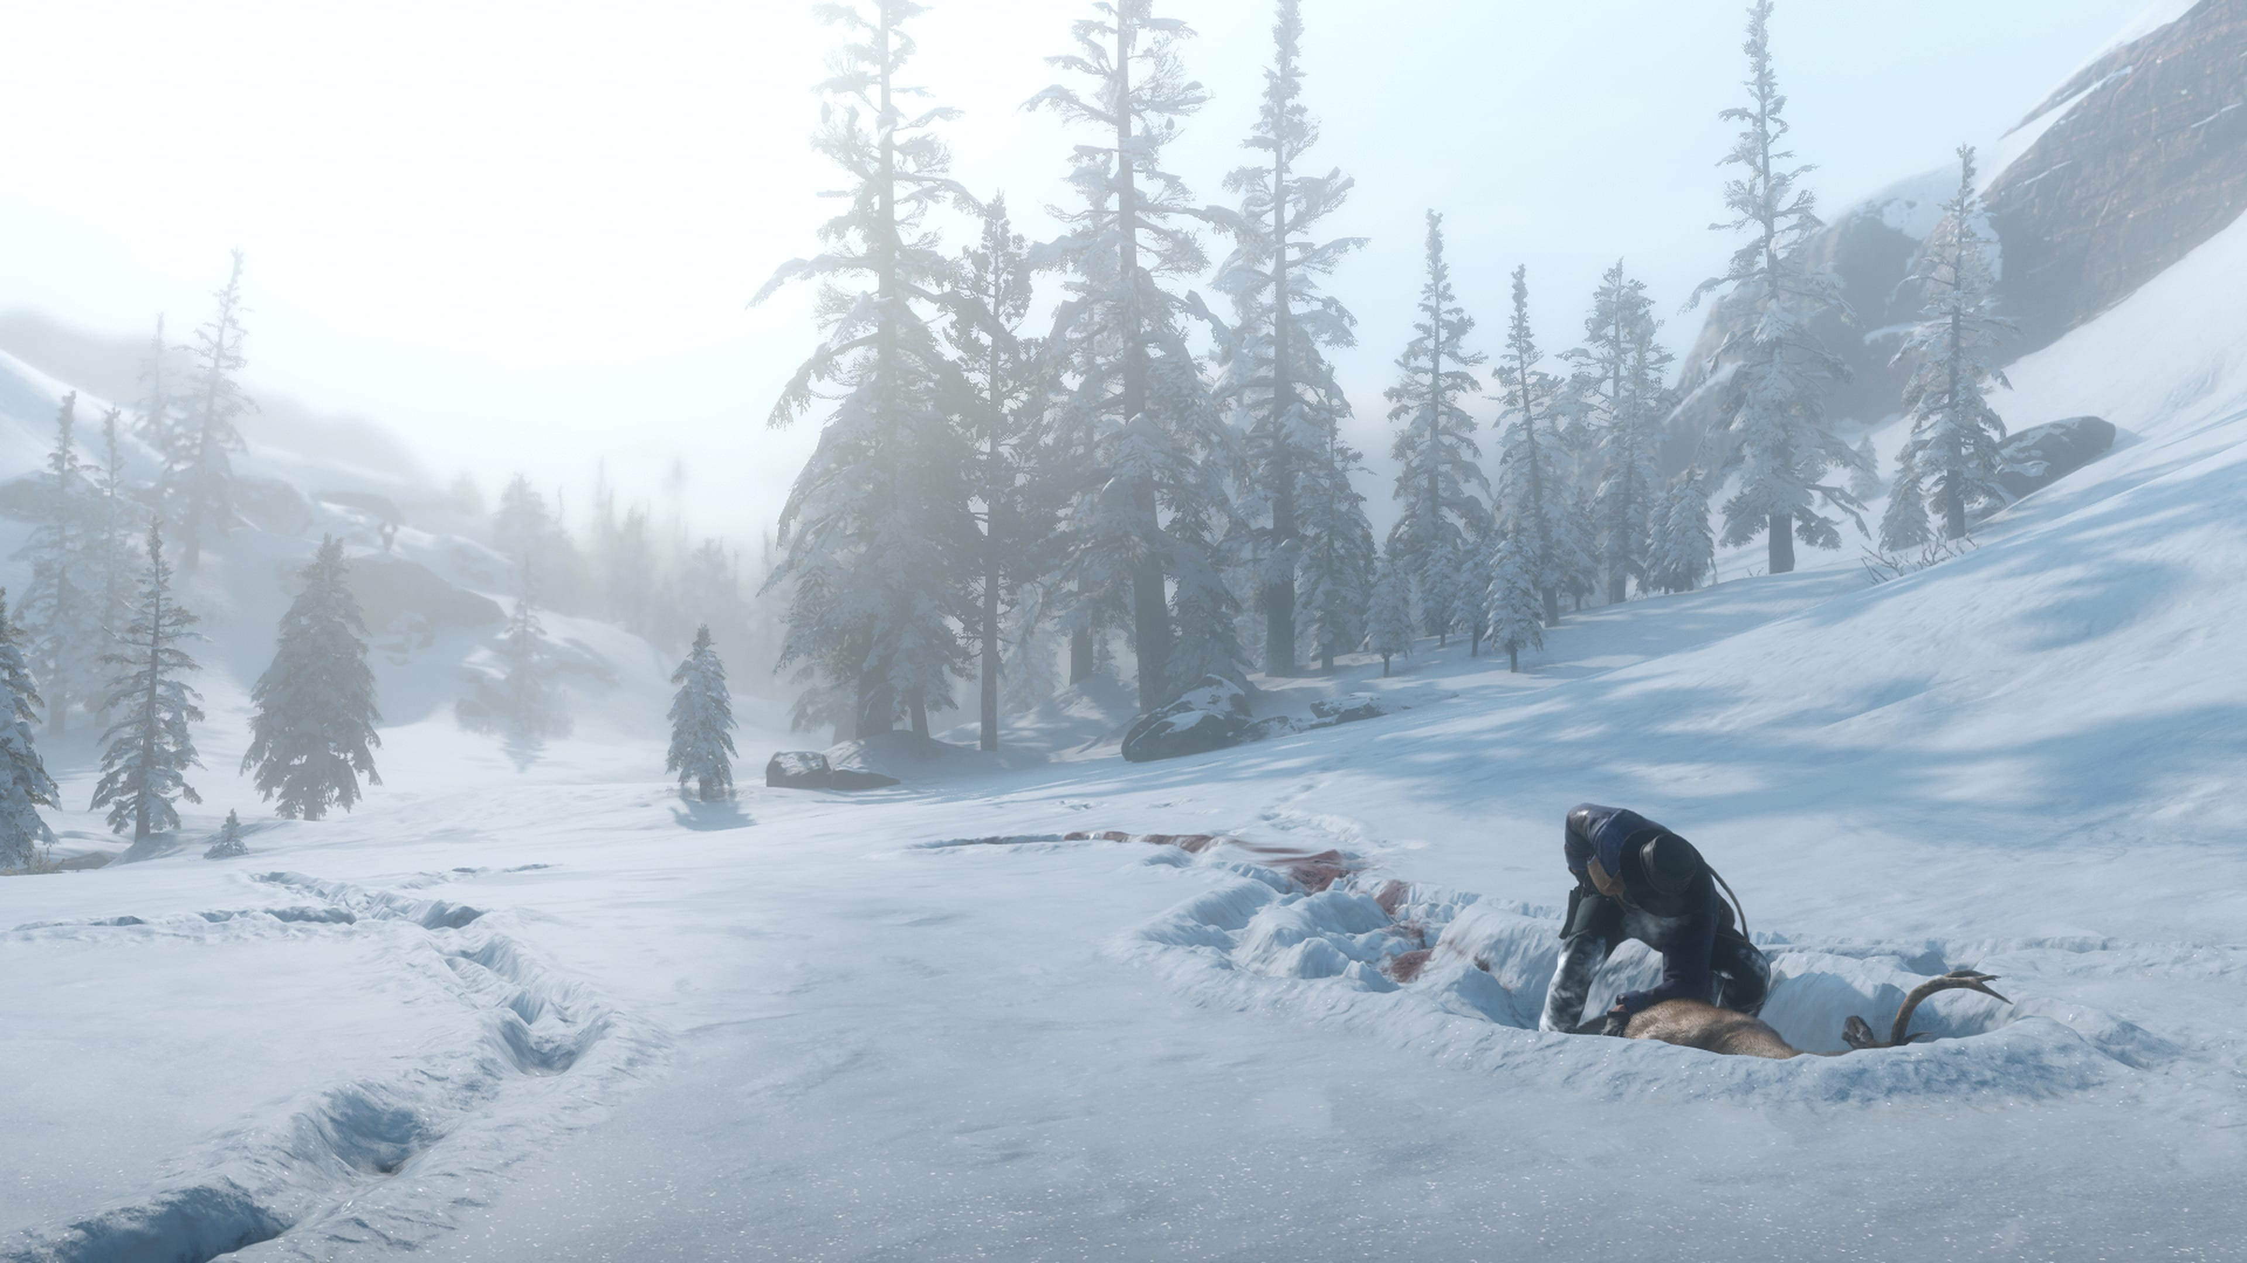
Inspiration
Red Dead Redemption 2
Fantastic Snow Physics
Other Games with Great Snow/Mud Physics
Snow Runner
Mud Runner
Image Source: https://i.redd.it/2g9njmrqq7o11.jpg

Slide 4
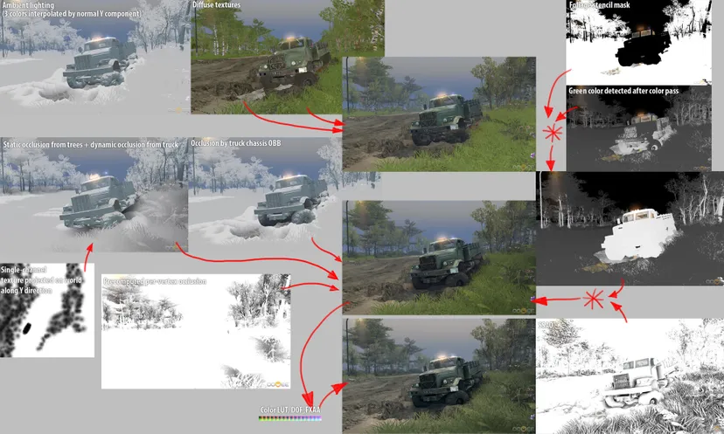
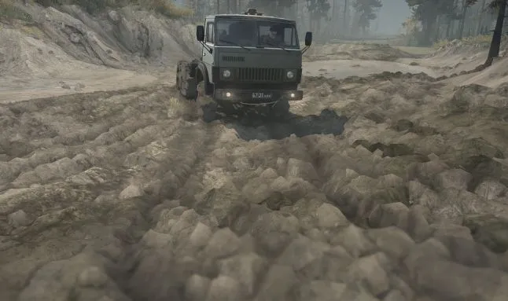
Inspiration
Source: https://www.gamedeveloper.com/programming/rendering-and-simulation-in-offroad-driving-game#close-modal
https://www.gamedeveloper.com/programming/mud-and-water-of-spintires-mudrunner#close-modal

Slide 5
Implementations
Similar to the height map!
Two Options:
Make the height map have slight variation based on small changes to the color of the texture
Have a separate texture to show the displacement due to depressions in snow and/or mud
Easiest solution!

Slide 6
Our Implementation
Our implementation uses a texture’s channels to manipulate height rendering
Red is the “active” layer which is a flat multiplier to the height of the terrain
Green is the horizontal layer moving terrain to the left or right
Blue is the vertical area moving terrain up and down

Slide 7
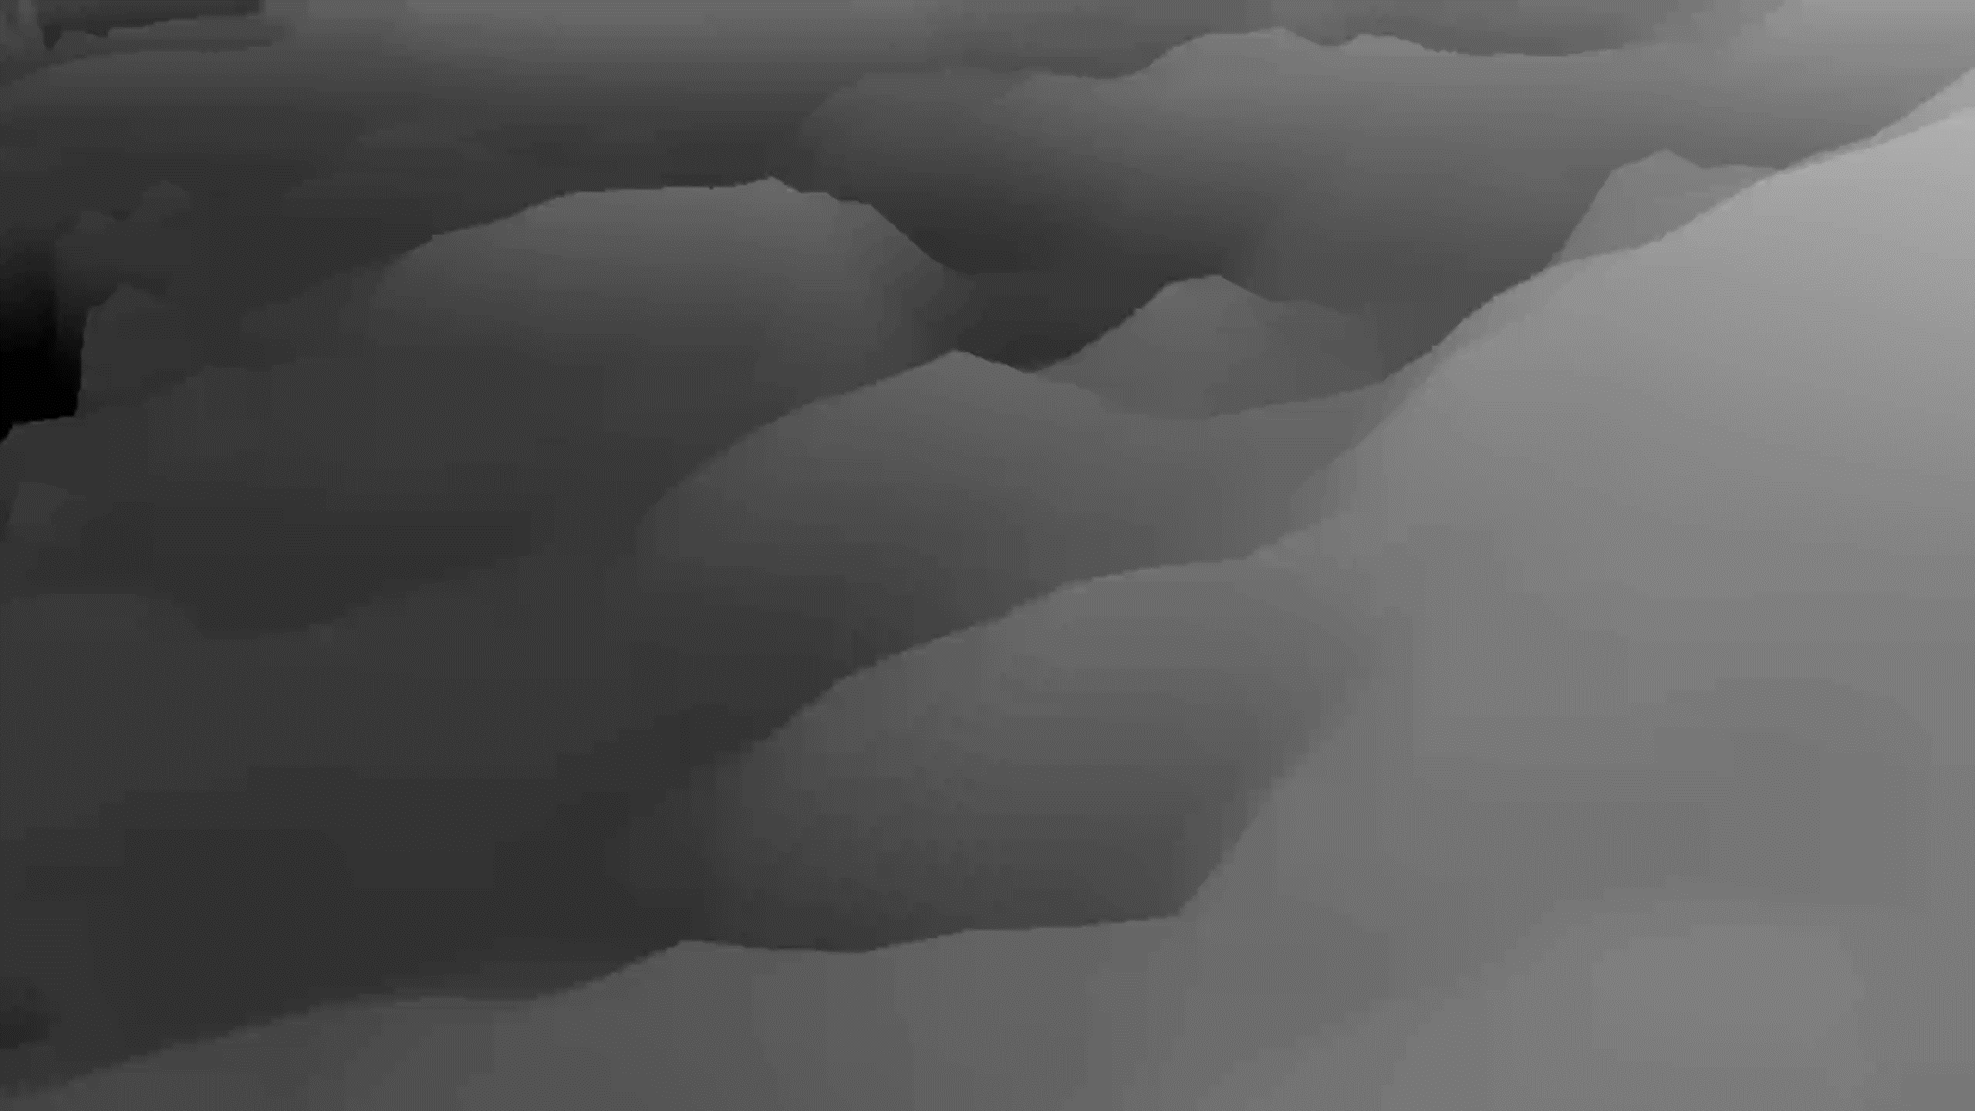

Demo

Slide 8
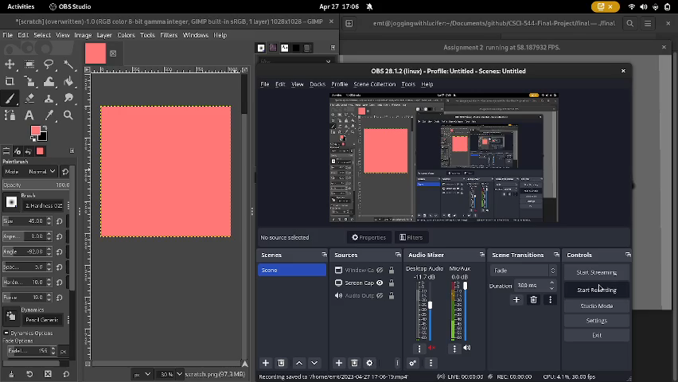
Demo

Slide 9
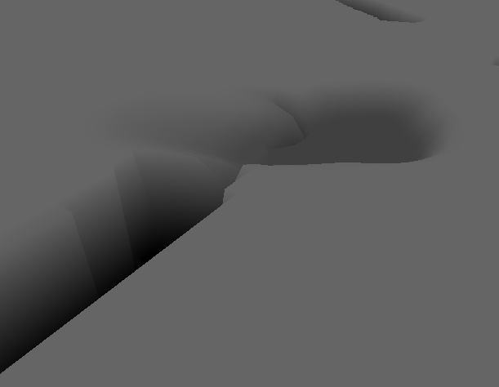
Example Foot Print

Slide 10
Sources
https://www.gamedeveloper.com/programming/rendering-and-simulation-in-offroad-driving-game
https://www.gamedeveloper.com/programming/mud-and-water-of-spintires-mudrunner
https://www.gamedev.net/forums/topic/700247-snow-physics-in-red-dead-redemption-2/5396779/

